Slide 1




Team-4 : Online Examination System
Cunning Wizards !!
Submitted By : Kartik Chawla - 10670528
Lakshya Khanna - 10670588
Saloni Bisht – 10670497
Batch - 848 . NET
Notes:
NOTE:
To change the image on this slide, select the picture and delete it. Then click the Pictures icon in the placeholder to insert your own image.

Slide 2

Objectives
Online Platform for Candidate Evaluation.
Self Evaluation Made Easy.
Clear Tests, Add Certifications.
Gradual rise in level to bring the best out of you.
Diversified Subjects and Technologies.
Instant Report Generation.
Get Question wise analysis for better understanding.

Slide 3




Features
Dynamic test Creation as per requirement .
Auto Report generation after test Completion .
Globally acknowledged Certifications.
Testing your Limits with increasing difficulty..
Graphical display for Correctness.
Get Question wise analysis for better understanding.

Slide 4
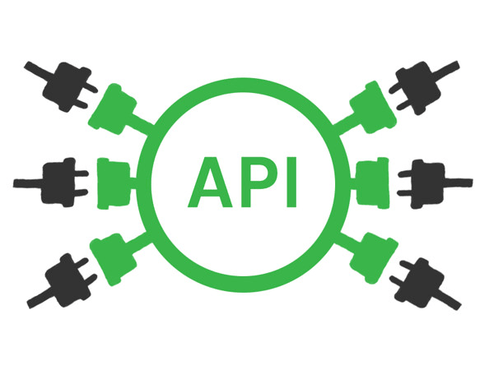
Methodology
Database Design
Generating Tables
Establishing links
Generating ER- Diagrams
Controllers using WebApi
Defining Methods/Models
Creating Business Logic
Front End using Angular
Final Integration
Integrating WebApi Components with Angular
Generating Components
Checks & Validations
Enabling Routing / Cookies
Creating LINQ EF Queries
Creating Models , Adapters & Services

Slide 5
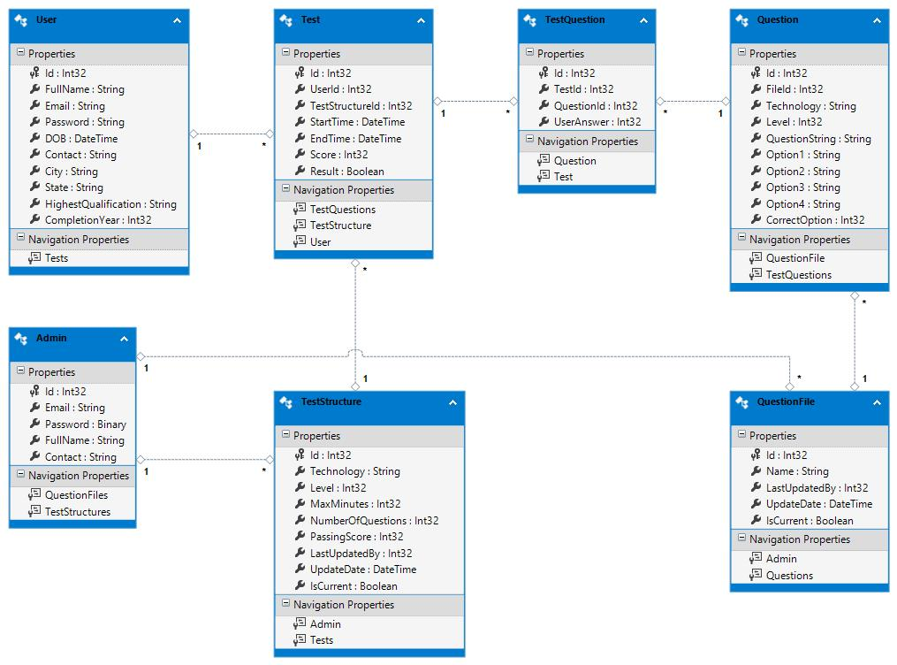
Database Design
List of Tables:
User Table
Admin Table
Question Files Table
Question Table
Test Structure Table
Test Table
Test Questions Table

Slide 6
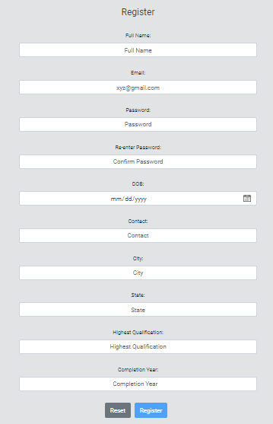
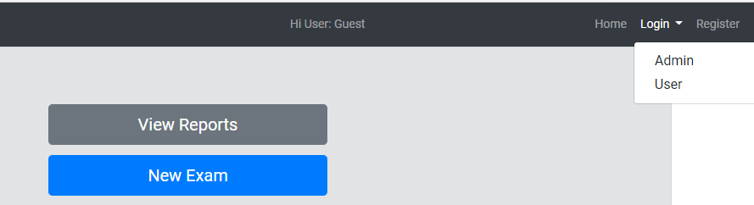
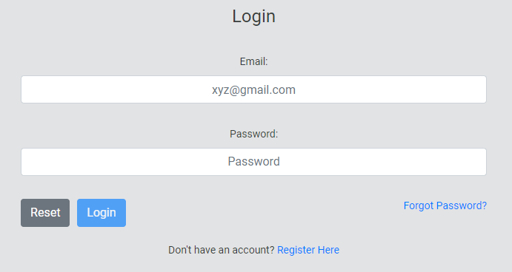
Project Overview

Slide 7
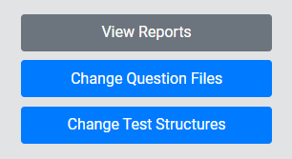
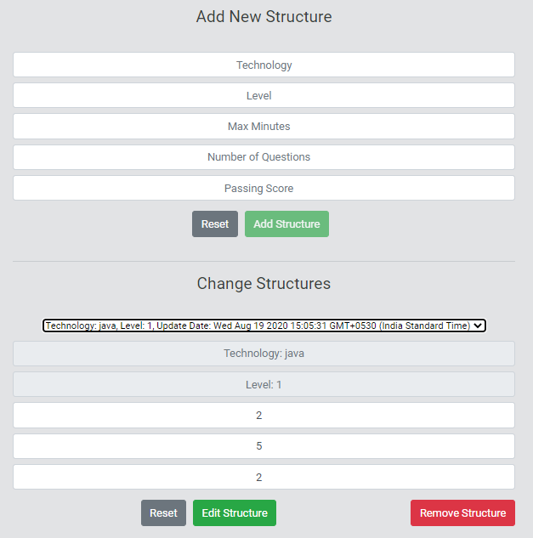
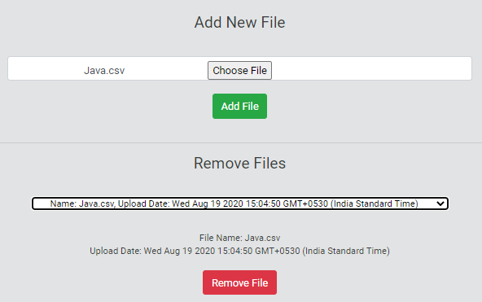
Project Overview

Slide 8
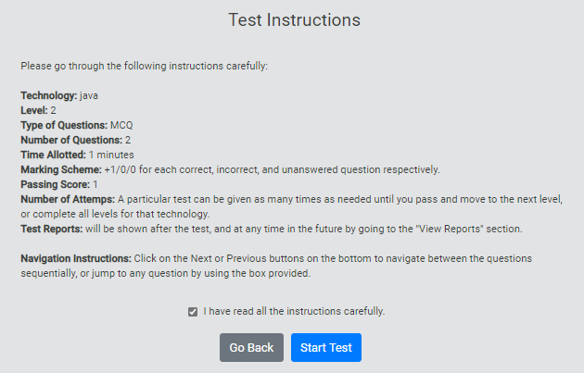
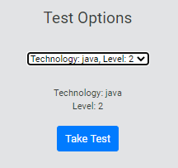
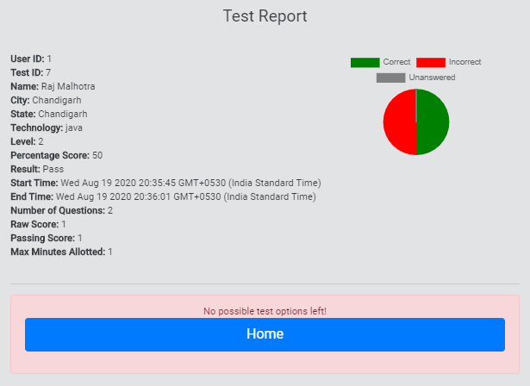
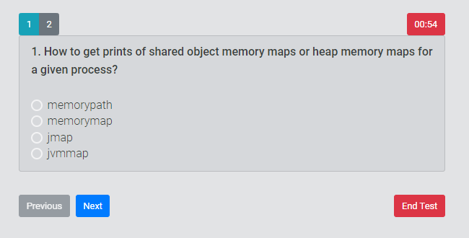
Project Overview

Slide 9
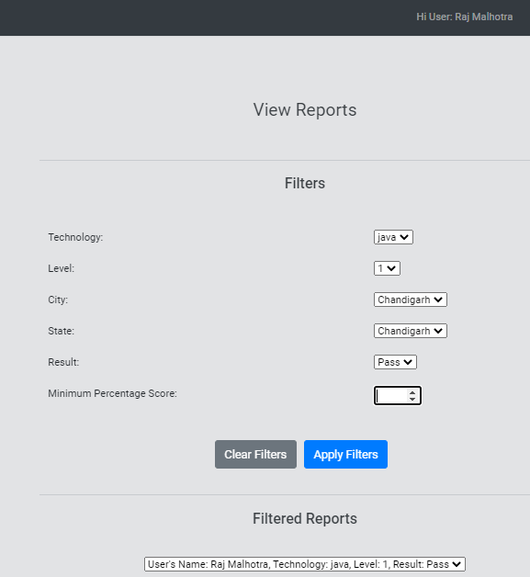
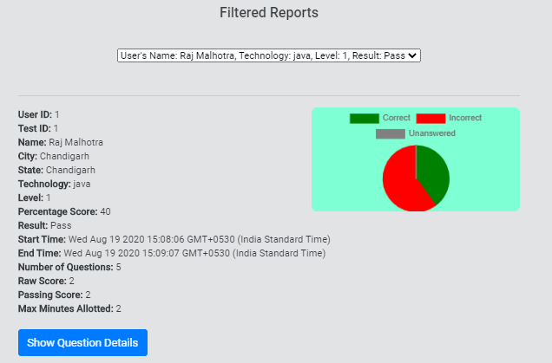
Project Overview

Slide 10





Challenges , Solutions & Learnings
Dynamic UI Timer for the candidate Test time Countdown.
Auto Submission of Test after time runs out.
Sending Mail Through SMTP for Password reset.
Implementing Cookies for Session Bound Data Transfer.
UI for displaying results via Charts.
Implementing SHA512 for secured Password Storage.
Unique Password reset requests.

Slide 11


